Slide 1
My Perimeter, Area and Volume Interactive Notebook
Name
Class
Term 3 Semester 2

Slide 2
Contents
Formula Page
Page
Date
Description
2
3

Slide 3
Tasks
24
7
30
Essential Question
Questions
Notes
Summary
24
25

Slide 4
24
7
30
Date
Surface Area of a Cylinder
EQ – Describe the process for finding the TSA of a cylinder.
25

Slide 5
Task – Sketch the net for the cylinder

Slide 6
Task – Sketch the net for the cylinder
Demo

Slide 7

24
7
30
Date
Surface Area of a Cylinder
EQ – Describe the process for finding the TSA of a cylinder.
r
$$h$$
The cylinder is formed from two circles and one rectangle
25

Slide 8

24
7
30
Date
Surface Area of a Cylinder
EQ – Describe the process for finding the TSA of a cylinder.
The cylinder is formed from two circles and one rectangle
$$h$$
25

Slide 9

24
7
30
Date
Surface Area of a Cylinder
EQ – Describe the process for finding the TSA of a cylinder.
The cylinder is formed from two circles and one rectangle
$$Area=$$
$$h$$
25

Slide 10

24
7
30
Date
Surface Area of a Cylinder
EQ – Describe the process for finding the TSA of a cylinder.
The cylinder is formed from two circles and one rectangle
$$Area=πr^{2}$$
$$h$$
25

Slide 11

24
7
30
Date
Surface Area of a Cylinder
EQ – Describe the process for finding the TSA of a cylinder.
The cylinder is formed from two circles and one rectangle
Same length as the circumference of the circle
$$2πr$$
$$Area=πr^{2}$$
$$h$$
25

Slide 12
24
7
30
Date
Surface Area of a Cylinder
EQ – Describe the process for finding the TSA of a cylinder.
The cylinder is formed from two circles and one rectangle
Same length as the circumference of the circle
$$2πr$$
$$Area=πr^{2}$$
$$h$$
TSA = 2 circles + 1 rectangle
=
25

Slide 13
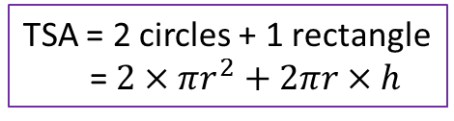
24
7
30
Date
Surface Area of a Cylinder
EQ – Describe the process for finding the TSA of a cylinder.
The cylinder is formed from two circles and one rectangle
Same length as the circumference of the circle
$$2πr$$
$$Area=πr^{2}$$
$$h$$
TSA = 2 circles + 1 rectangle
= $2×πr^{2}+2πr×h$
25

Slide 14
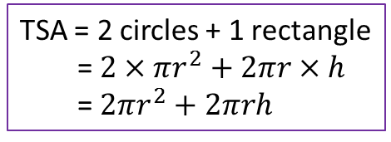
24
7
30
Date
Surface Area of a Cylinder
EQ – Describe the process for finding the TSA of a cylinder.
The cylinder is formed from two circles and one rectangle
Same length as the circumference of the circle
$$2πr$$
$$Area=πr^{2}$$
$$h$$
TSA = 2 circles + 1 rectangle
= $2×πr^{2}+2πr×h$
= $2πr^{2}+2πrh$
25

Slide 15
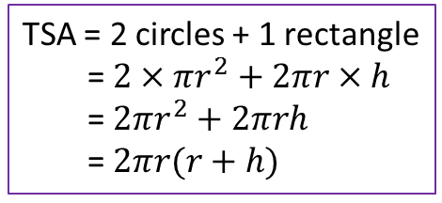
24
7
30
Date
Surface Area of a Cylinder
EQ – Describe the process for finding the TSA of a cylinder.
The cylinder is formed from two circles and one rectangle
Same length as the circumference of the circle
$$2πr$$
$$Area=πr^{2}$$
$$h$$
TSA = 2 circles + 1 rectangle
= $2×πr^{2}+2πr×h$
= $2πr^{2}+2πrh$
= $2πr(r+h)$
25

Slide 16
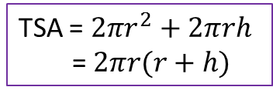

24
7
30
Date
Volume of a Prism
EQ – Describe how the formula for the area of a circle is used to find the volume of a cylinder?
TSA = $2πr^{2}+2πrh$
= $2πr(r+h)$
r
$$h$$
10cm
6cm
19

Slide 17
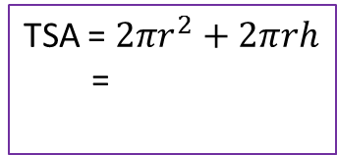
24
7
30
Date
Volume of a Prism
EQ – Describe how the formula for the area of a circle is used to find the volume of a cylinder?
TSA = $2πr^{2}+2πrh$
= $2πr(r+h)$
r
$$h$$
10cm
TSA = $2πr^{2}+2πrh$
=
6cm
19

Slide 18
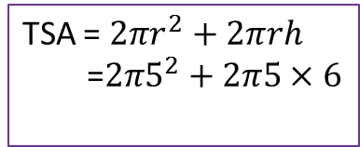
24
7
30
Date
Volume of a Prism
EQ – Describe how the formula for the area of a circle is used to find the volume of a cylinder?
TSA = $2πr^{2}+2πrh$
= $2πr(r+h)$
r
$$h$$
10cm
TSA = $2πr^{2}+2πrh$
=$2π5^{2}+2π5×6$
6cm
19

Slide 19
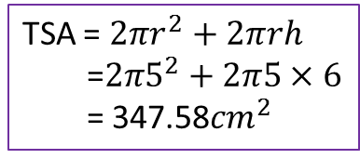
24
7
30
Date
Volume of a Prism
EQ – Describe how the formula for the area of a circle is used to find the volume of a cylinder?
TSA = $2πr^{2}+2πrh$
= $2πr(r+h)$
r
$$h$$
10cm
TSA = $2πr^{2}+2πrh$
=$2π5^{2}+2π5×6$
= 347.58${cm}^{2}$
6cm
19

Slide 20
Questions

Slide 21
24
7
30
Date
Surface Area of a Cylinder
EQ – Describe the process for finding the TSA of a cylinder.
What does the net of a cylinder look like?
r
$$h$$
The cylinder is formed from two circles and one rectangle
25

Slide 22
24
7
30
Date
Surface Area of a Cylinder
EQ – Describe the process for finding the TSA of a cylinder.
What is the net made up of?
The cylinder is formed from two circles and one rectangle
Same length as the circumference of the circle
$$2πr$$
$$Area=πr^{2}$$
$$h$$
How do I find the Surface Area?
TSA = 2 circles + 1 rectangle
= $2×πr^{2}+2πr×h$
= $2πr^{2}+2πrh$
= $2πr(r+h)$
25

Slide 23
24
7
30
Date
Volume of a Prism
EQ – Describe how the formula for the area of a circle is used to find the volume of a cylinder?
TSA = $2πr^{2}+2πrh$
= $2πr(r+h)$
r
$$h$$
Example
10cm
TSA = $2πr^{2}+2πrh$
=$2π5^{2}+2π5×6$
= 347.58${cm}^{2}$
6cm
19

Slide 24
Notes Review
24, 7 ,30
Date
Title
Essential question
Notes complete
Notes complete with colour and diagrams
Questions completed
Contents page filed in
Formula page filled in

Slide 25
Homework
Review your notes and write a summary answering the essential question.

Slide 26
Plenary
Draw three shapes with a perimeter of 36cm.

